Slide 1
USED CAR ANALYSIS
SARTHAK AGRAWAL

Slide 2
WE ARE GOING TO DISCUSS FOLLOWING POINTS :-
INTRODUCTON OF THE PROJECT
WEB SCRAPING PROCESS
SQL DATA EXTRACTION AND ANALYSIS
EXCEL DASHBOARD DEVELOPMENT
KEY INSIGHTS AND RECOMMENDATION

Slide 3
INTRODUCTON OF
THE PROJECT

Slide 4
INTRODUCTON OF THE PROJECT
In this project we analysis the used car data and try to find out the useful insights which is useful for company’s business and decision making. By this way a company or a buyer can take a smart decision. In this project I used my several analytical skills which are following :-
1) Ethical Web Scraping
2) Data Cleaning
3) SQL
4) Excel Dashboard
5) Final insights from the data and Dashboard

Slide 5
WEB SCRAPING PROCESS

Slide 6

WEB SCRAPING PROCESS
For the Web scraping I used the selenium library and we should be careful while scraping the data from the web site. Because cars24 web site is infinity scrolling website that why I used selenium library.
I paste my selenium code in the next page. We can get the idea how can I scrap the data from the web site by selenium.

Slide 7
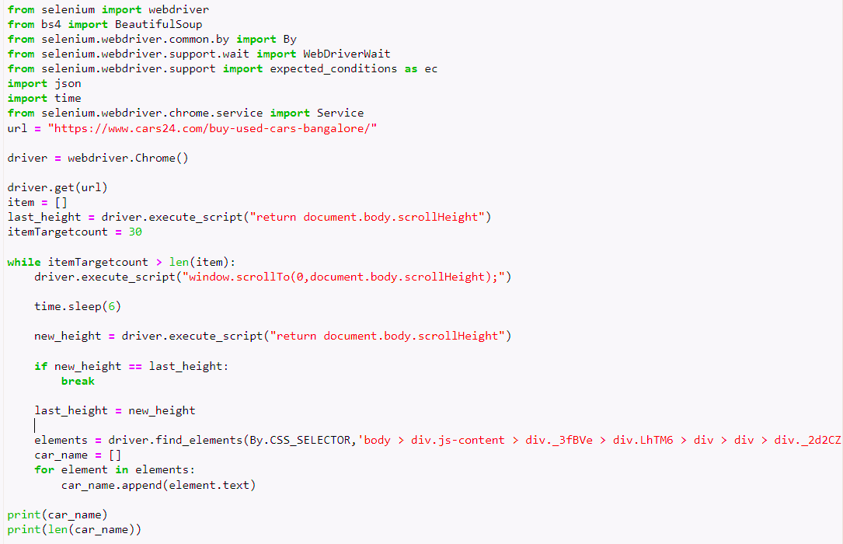

Slide 8
Data Cleaning

Slide 9
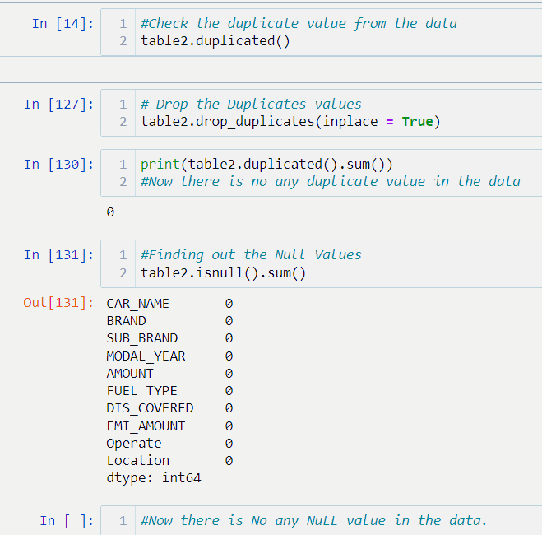

Data Cleaning
I checked duplicates and null values. If duplicates are present then I cleaned it in python with help of pandas library. I have past the screen sort of my code.

Slide 10
SQL DATA EXTRACTION
AND ANALYSIS

Slide 11

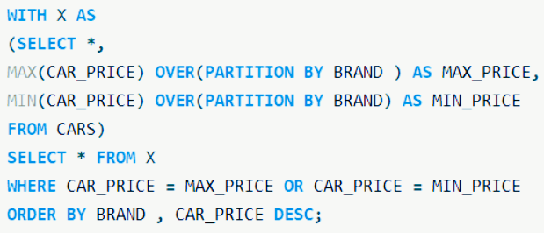
SQL DATA EXTRACTION AND ANALYSIS
INSIGHT (1)
The least expensive and most expensive cars for each brand along with their specifications.

Slide 12
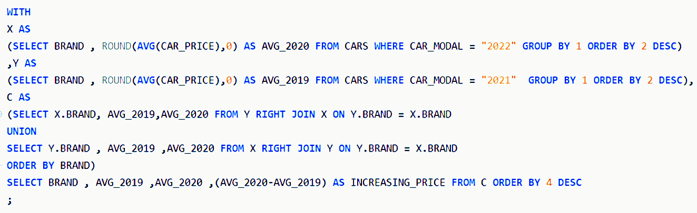
SQL DATA EXTRACTION AND ANALYSIS
INSIGHTS(2):-
A comparison of the average prices of cars from each brand this year to those from last year.

Slide 13
EXCEL DASHBOARD
DEVELOPMENT

Slide 14
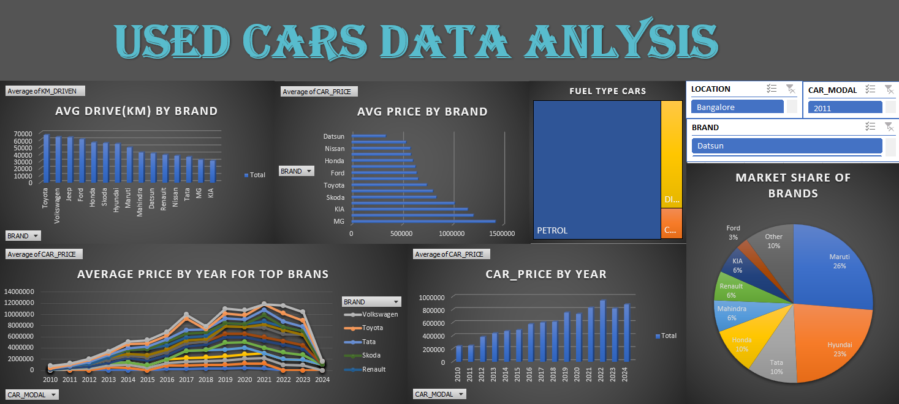
EXCEL DASHBOARD DEVELOPMENT

Slide 15
KEY INSIGHTS
AND RECOMMENDATION

Slide 16

INSIGHTS(1)
DOMINATING PLAYERS :-
Maruti (26%)
Hyundai (23%)
Tata (10%)
Honda (10%)
These Company having 69% market share of Indian car.

Slide 17
INSIGHTS(2)
Brands Average Price of the Cars
Top 5 low price car brand
Datsun
Maruti
Nissan
Renault
Honda
Top 3 high price car brand
MG
Jeep
KIA
Low price cars have high demand in India that why they are dominating.

Slide 18
INSIGHTS(3)
If we observe the bar chart carefully then we can see the pattern between the car price and time.
So car price is inverse proportional to the time. It means if the car is too old then its price have to very low and vice versa.

Slide 19
INSIGHTS(4)
According to the chart following cars are driven so much :-
Toyota
Volkswagen
Jeep
Ford
Honda
Mostly Brand are medium expensive. So expensive car have high change not to sell.

Slide 20
INSIGH CONCLUTION
(1) People are interested to sell their own car on average after 6.2 year.
(2) Maruti, Hyundai, Tata, Honda are the dominating brand in India and having large market share.
(3) Maruti, Honda have low average car price. This indicates that a brand which has low average car price is dominate in Indian market.
(4) Car rates is inverse proportion to time duration (How old it is).
(5) 78% Cars are petrol.
(6) Average Car Price is 6.5 L means car which is having the prise near 6.5L is demanding in the market.

Slide 21
LINKS
This is google drive link where you can see my python coding file and SQL query, Excel File.
CTRL+CLICK HERE

Slide 22

THANK YOU
ANALYSIS BY
SARTHAK AGRAWAL

